Slide 1
Article Posting
ORM / webservices: FINAL PROJECT
Group Member
Chea Chan
Chea Devit
Chhoeung Chhunhak
Roern Chantha
Neam Sinat
Thorng Danet

Slide 2
Agendas
Introduction
Project Scope
Project Features
Problems & Solutions
Purpose
Questions & Answers

Slide 3
Introduction
Description: Article Post is providing the news and articles within Entertainment, Sports, Technologies, Socials news and it is a website that can help the human to daily activities. It is very important for people's life currently, because it gains knowledge of everything like working, news, general knowledge, and technology.
Technologies:
Front-end technologies within HTML+CSS+JAVASCRIPT, Bootstrap
Back-end technologies within Laravel framework and MySQL database

Slide 4
II. Project scope
Guest: Not require to login into our system they can view the articles post with the different categories and click for more detail for each post. However they also can share the article to Facebook and Telegram.
Admin User: require to login into our system with the Email & Password then they can work on Articles Management, User Management and Categories Management.

Slide 5
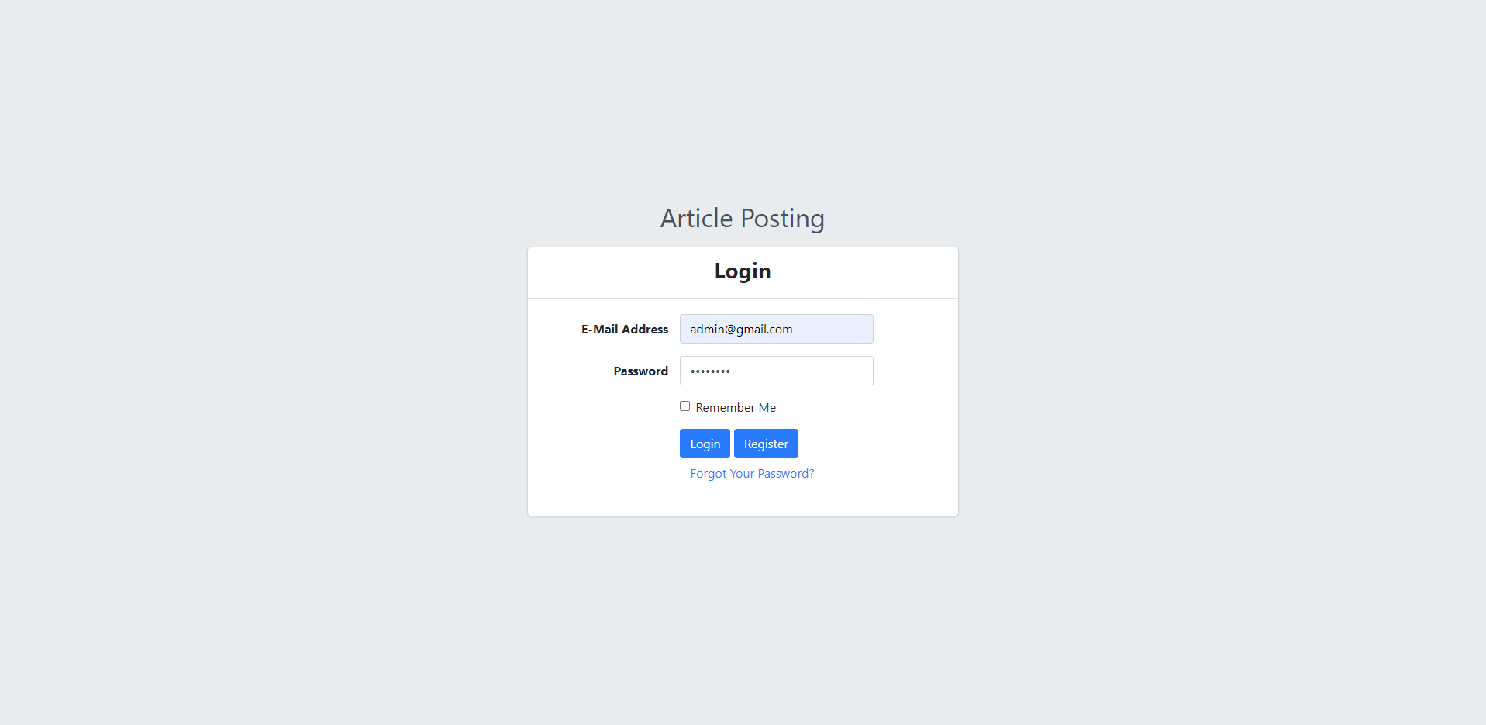
III. Project Features
User Management
User Login

Slide 6
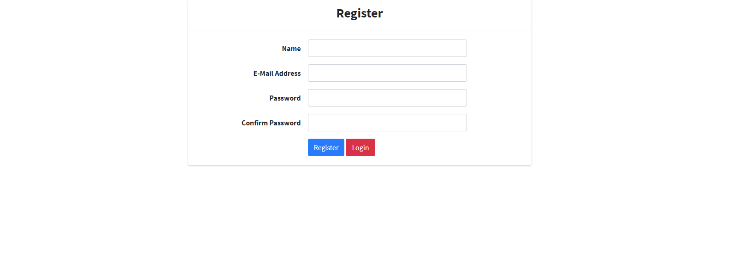
III. Project Features
User Management
User Register

Slide 7
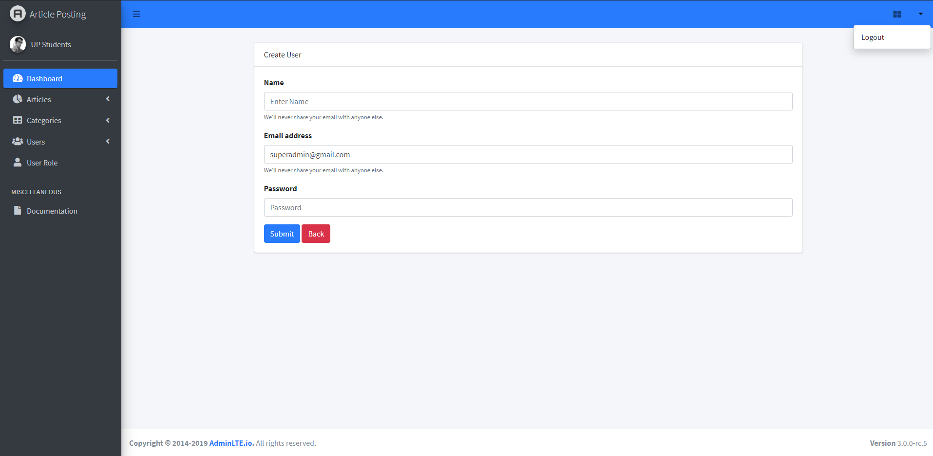
III. Project Features
User Management
User Logout

Slide 8
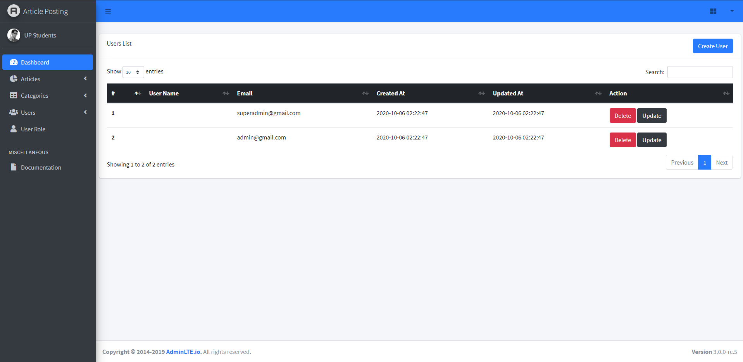
III. Project Features
User Management
User list

Slide 9
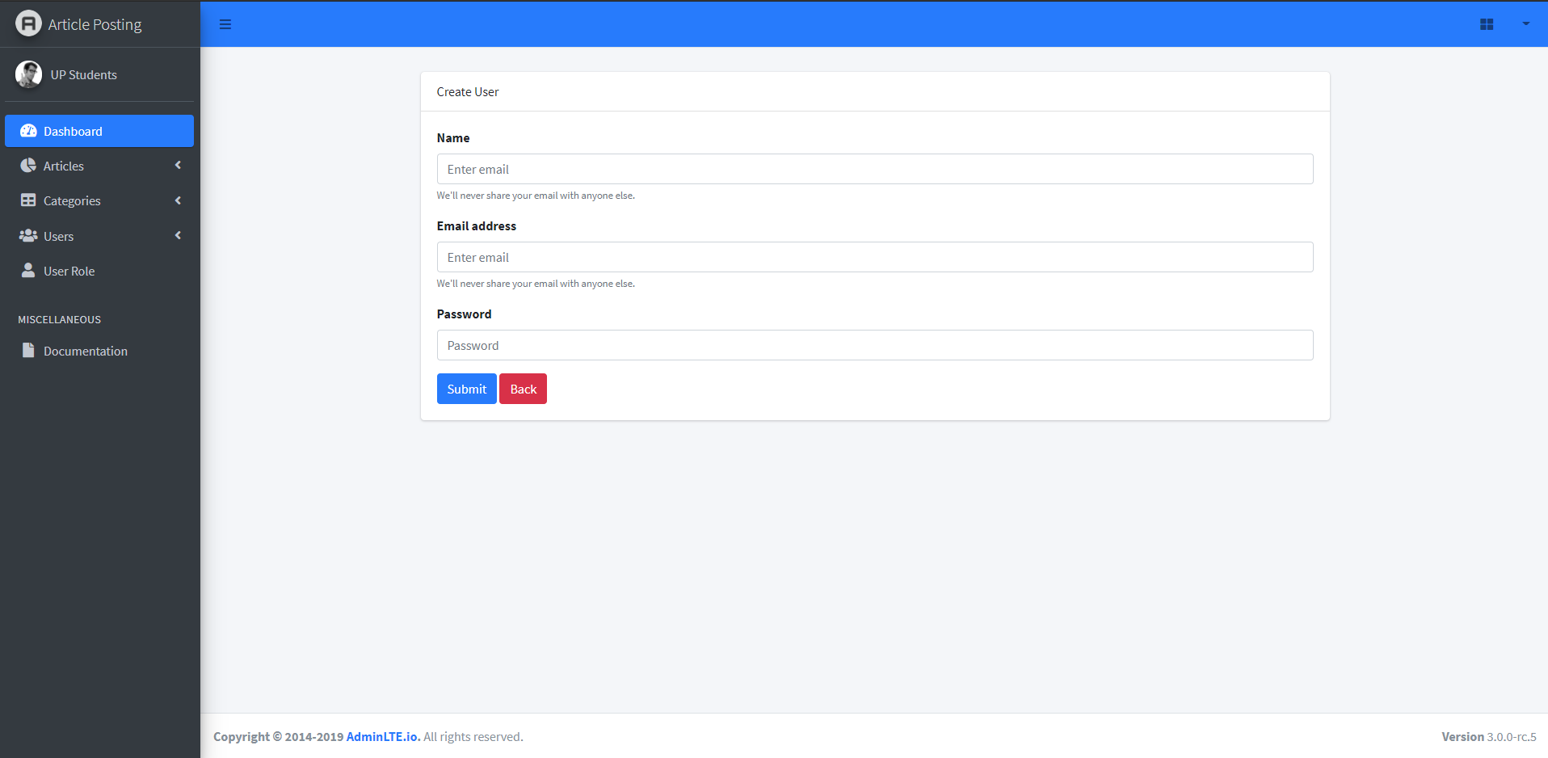
III. Project Features
User Management
Add User

Slide 10

III. Project Features
User Management
Edit User
Delete User

Slide 11
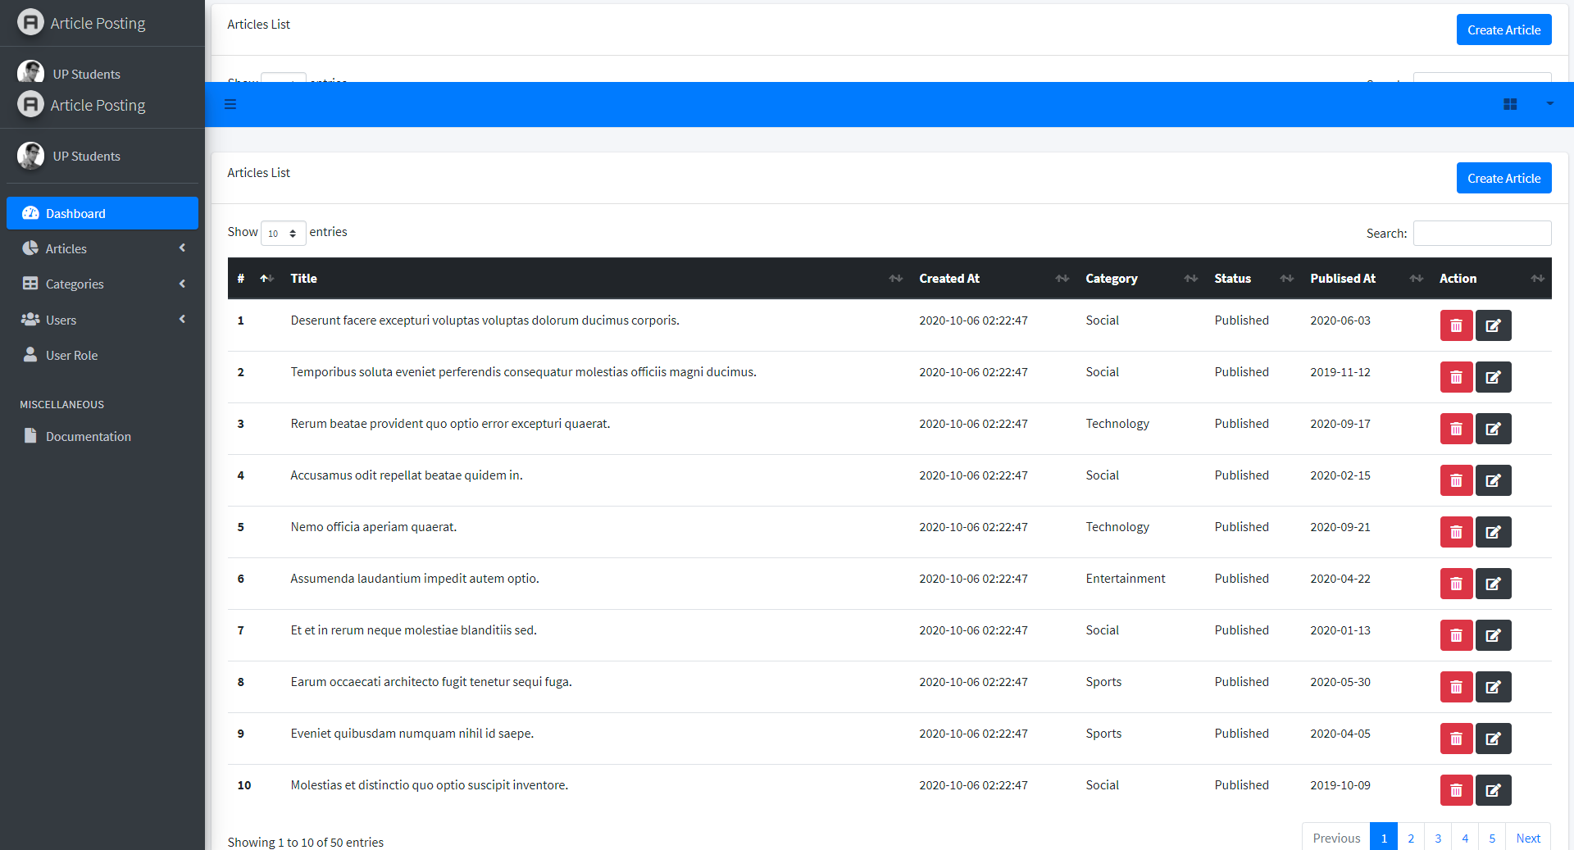
III. Project Features
Article
List Article

Slide 12
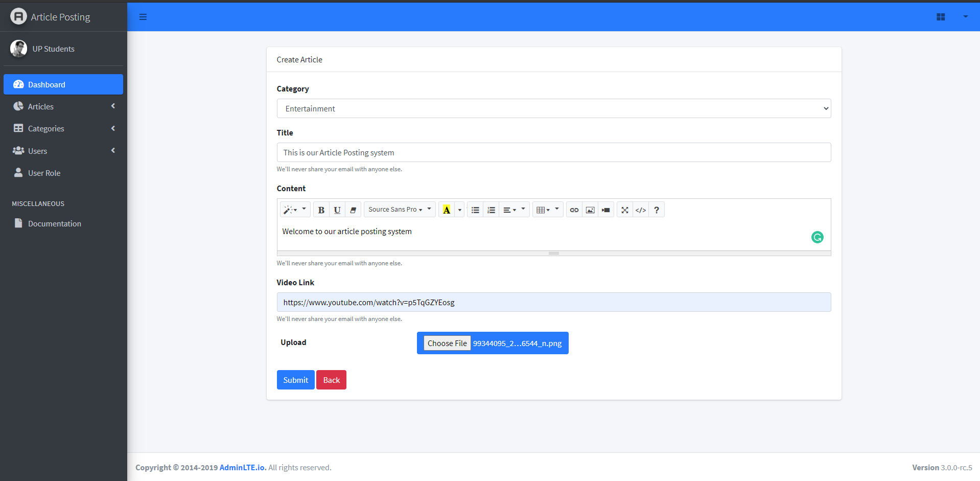
III. Project Features
Article Management
Add Article

Slide 13
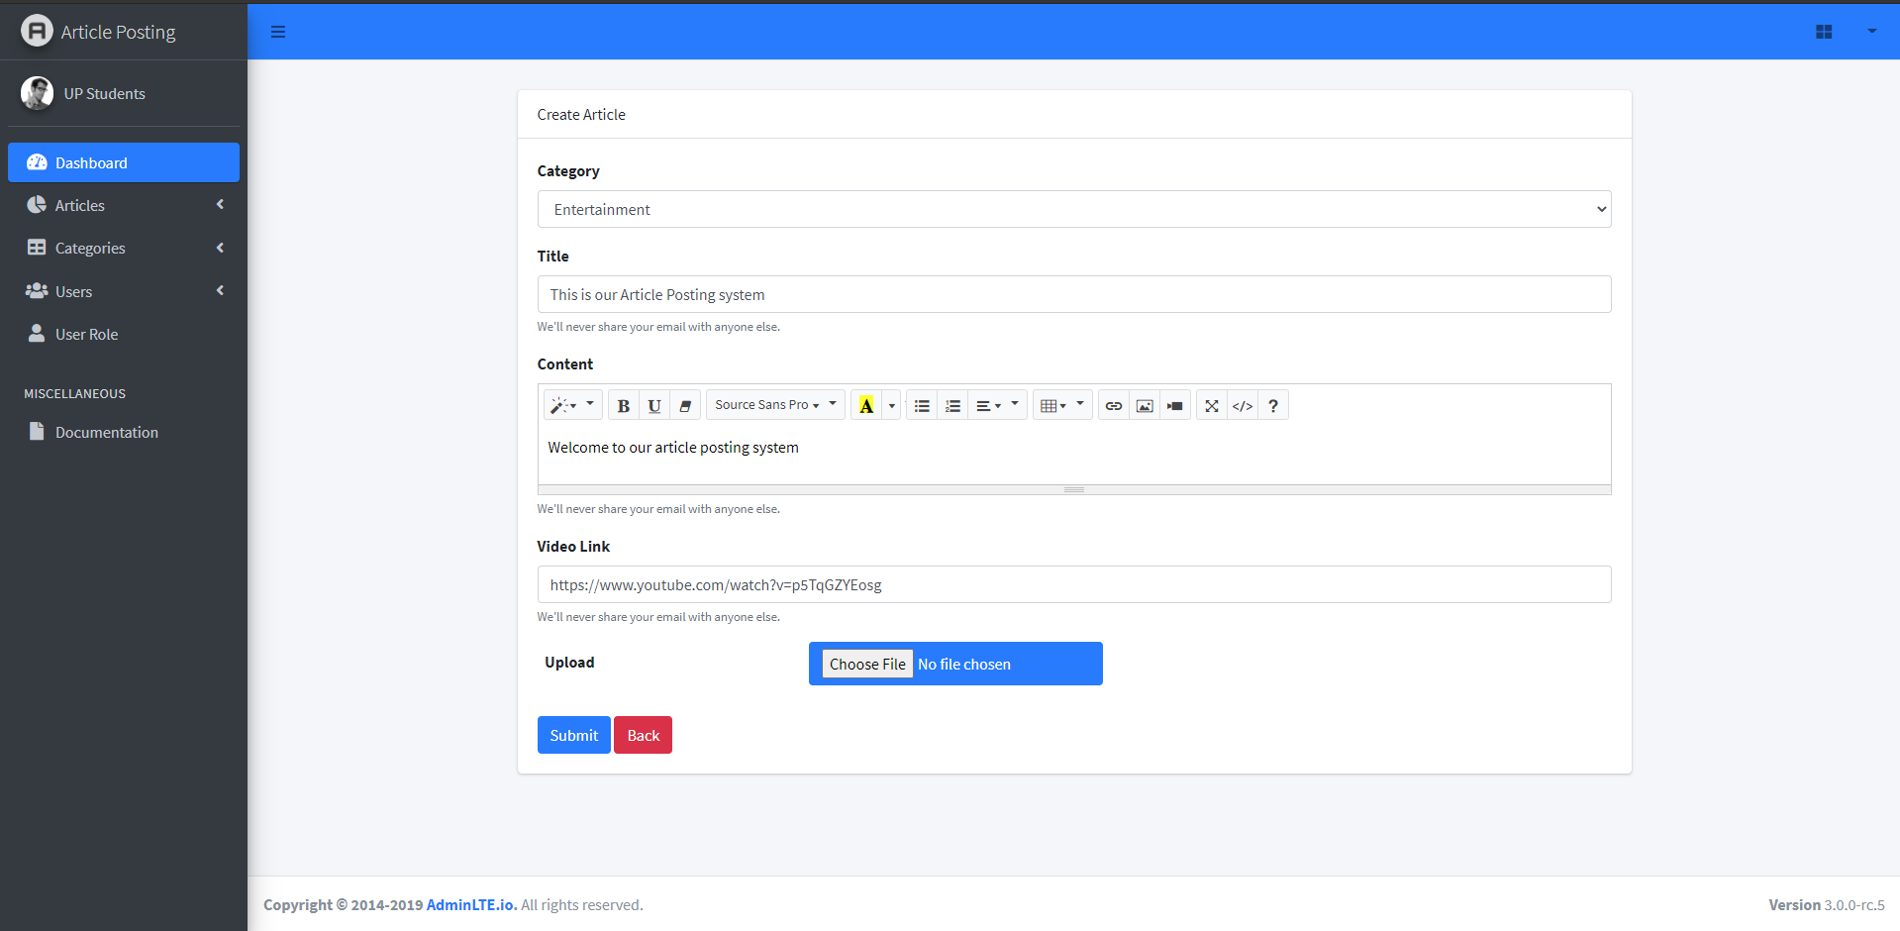
III. Project Features
Article Management
Edit Article
Delete Article

Slide 14
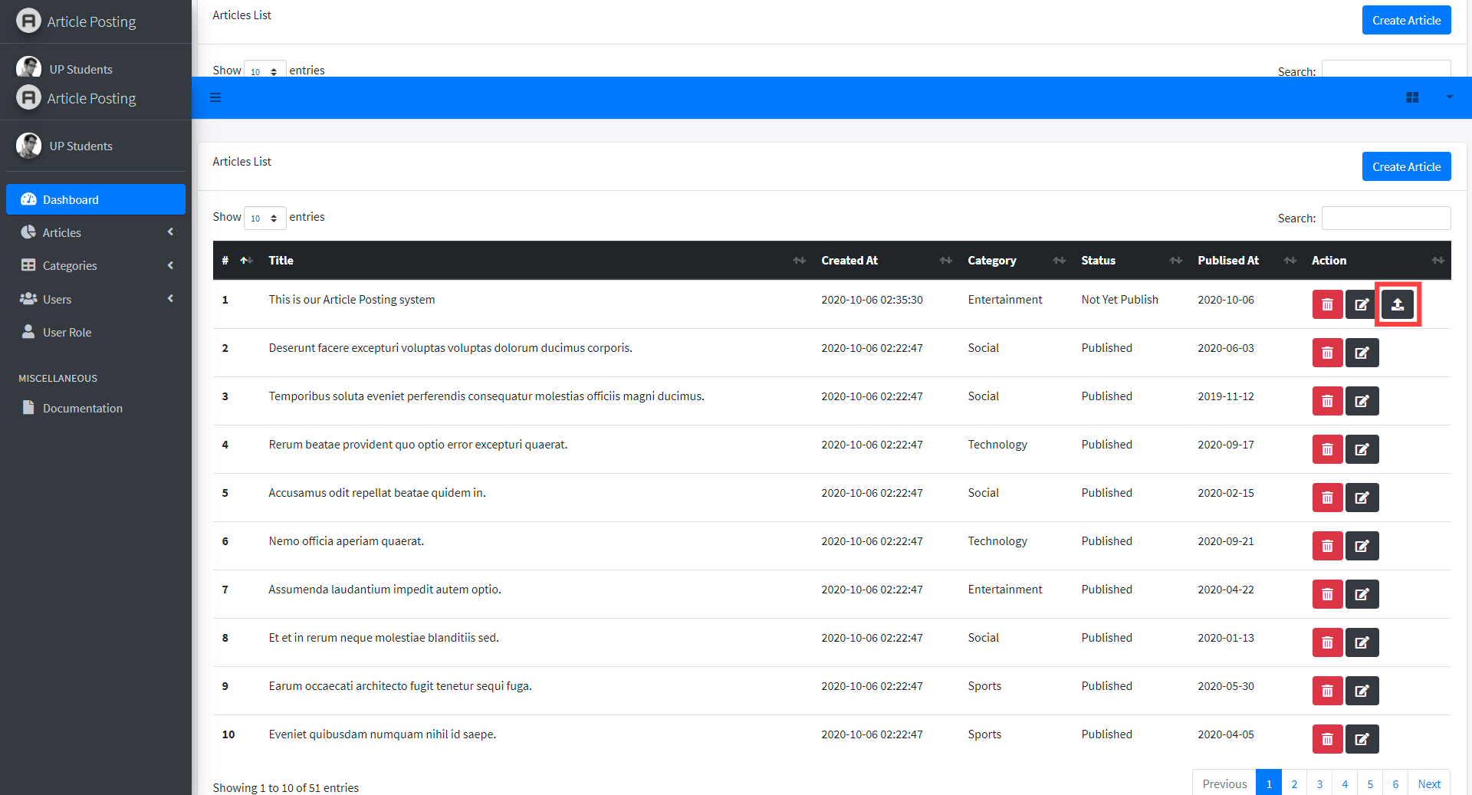
III. Project Features
Article Management
Publish

Slide 15
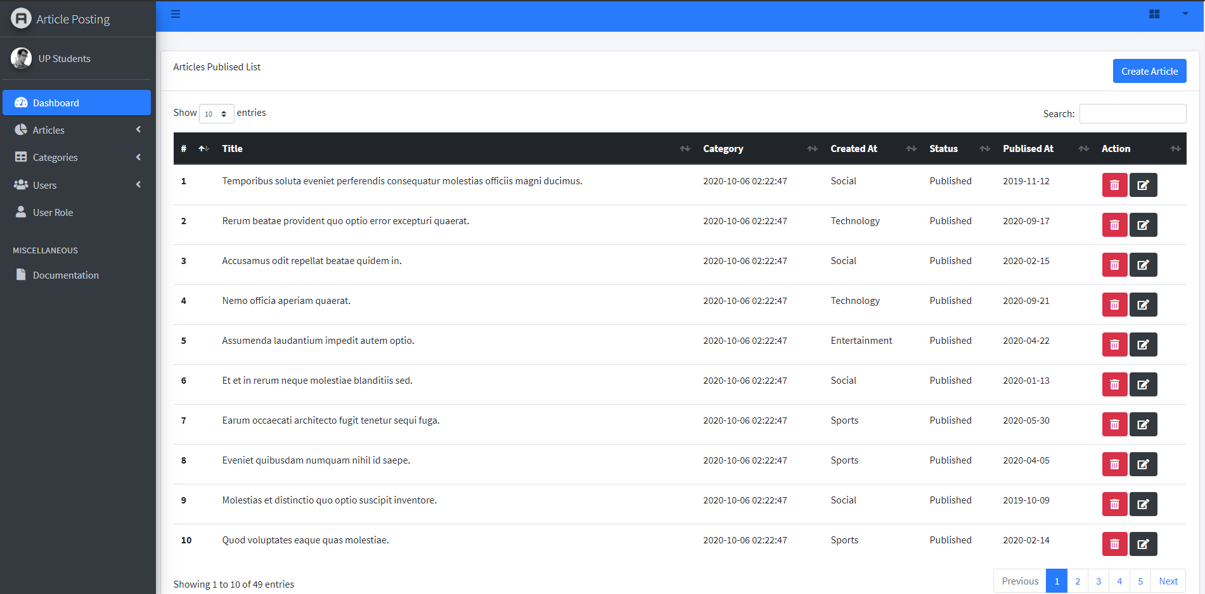
III. Project Features
Article Management
Publish List

Slide 16
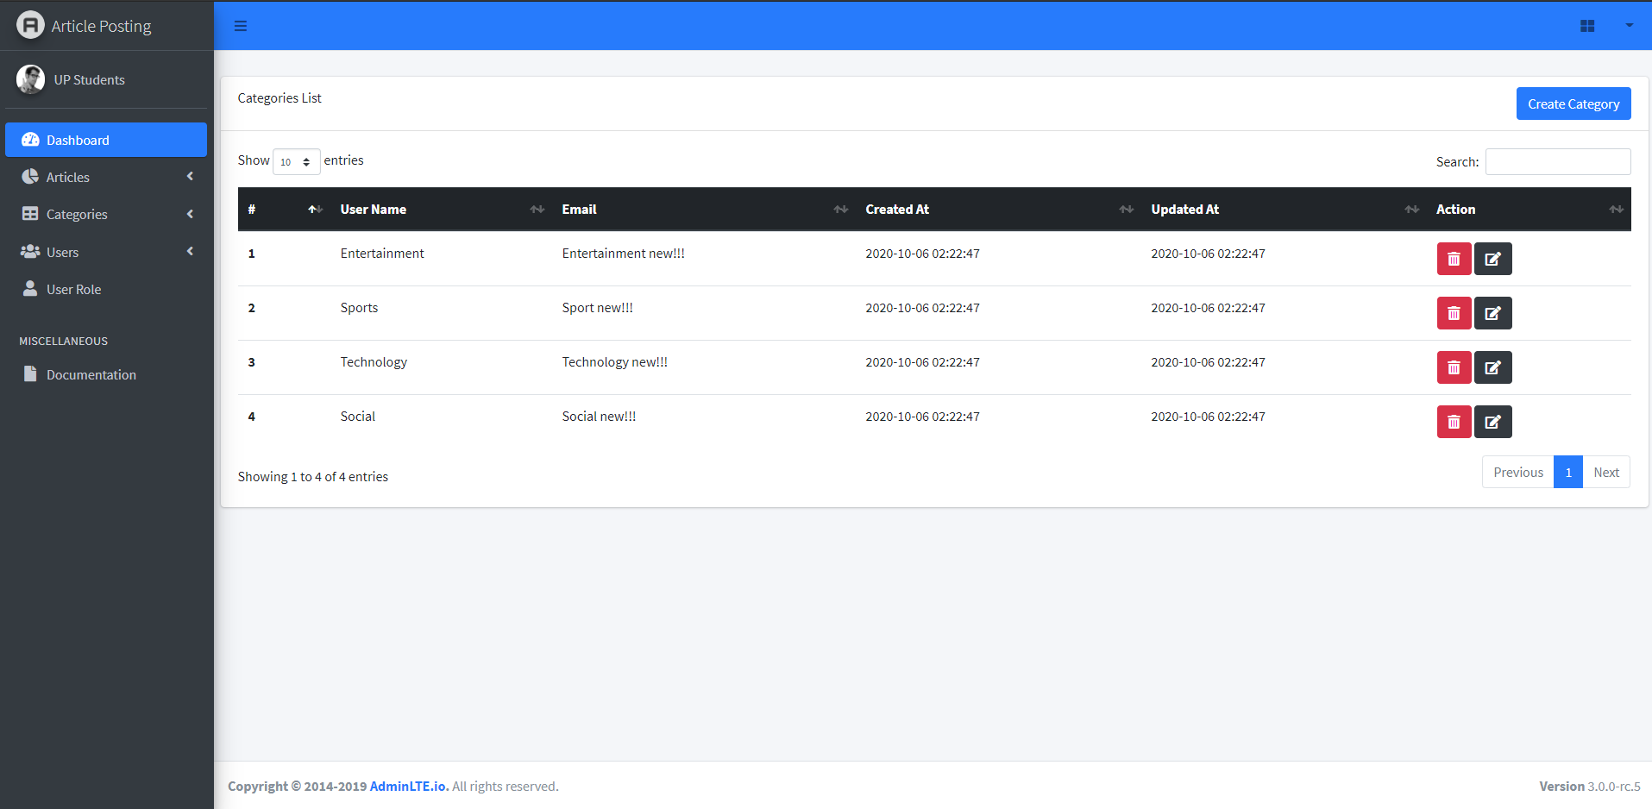
III. Project Features
Category Management
Category lists

Slide 17
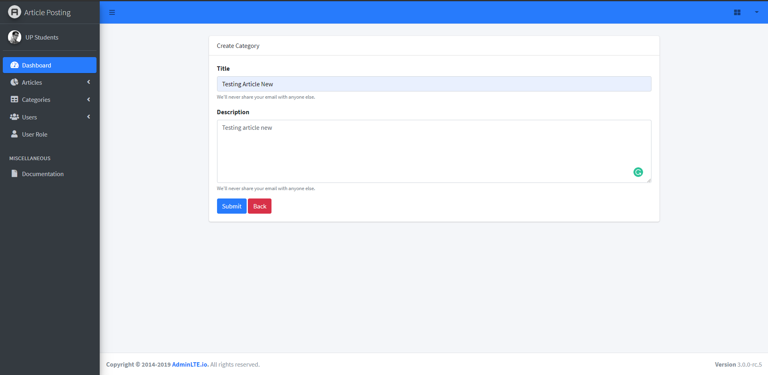
III. Project Features
Category Management
Add Category

Slide 18
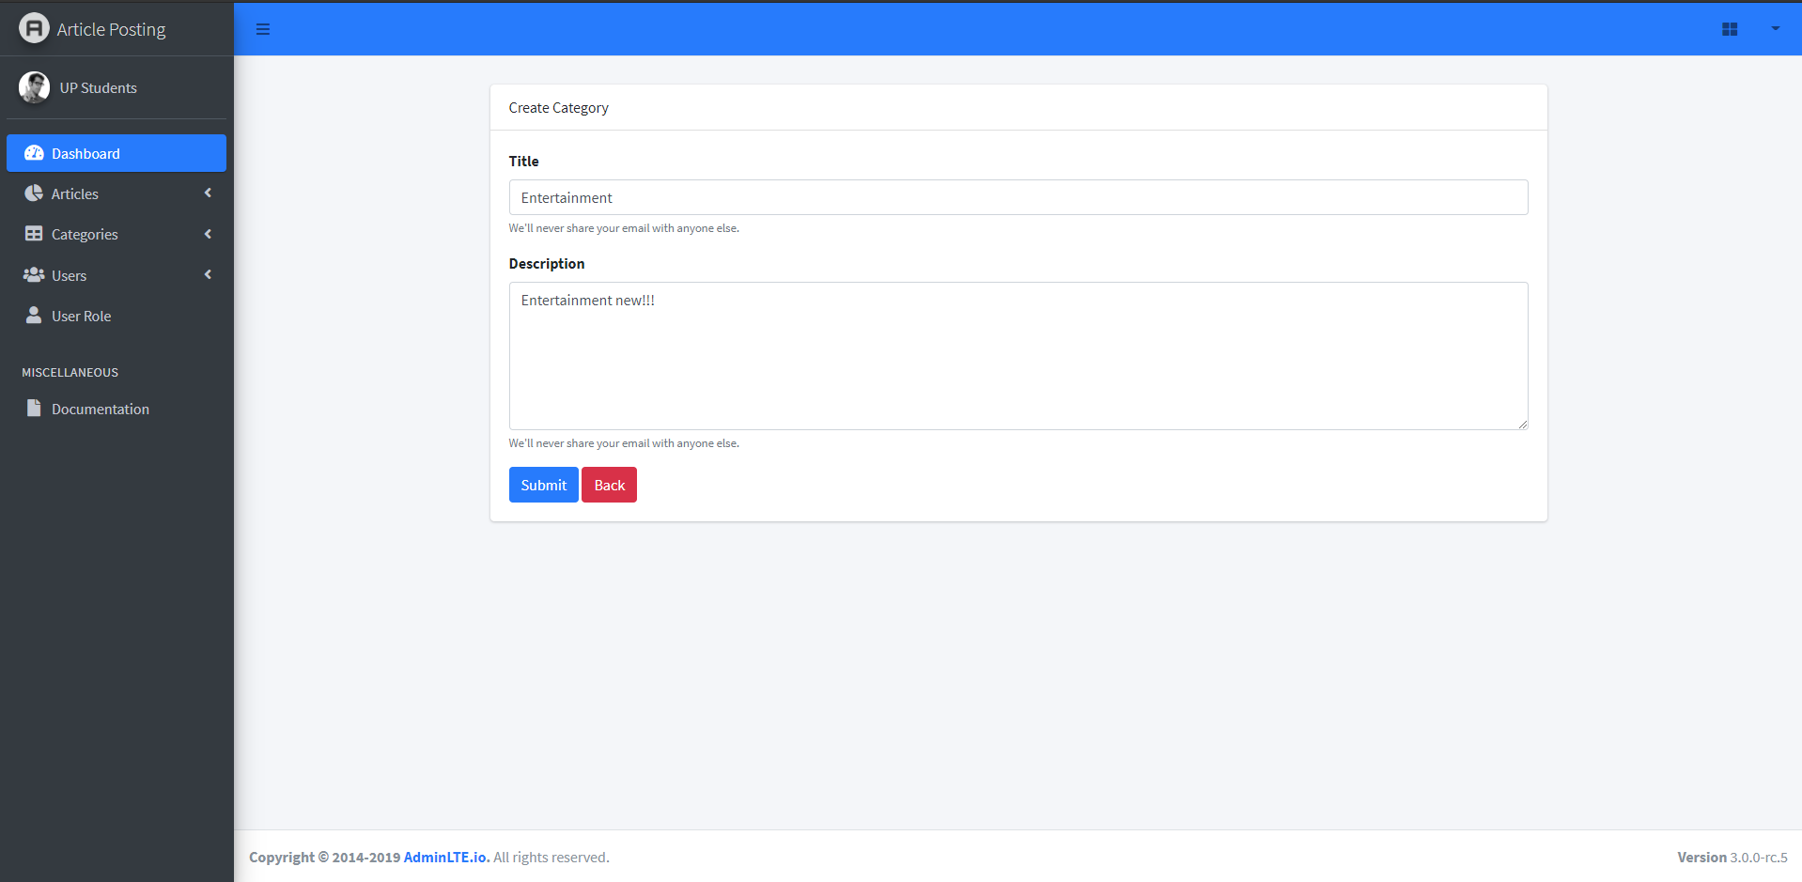
III. Project Features
Category Management
Edit Category

Slide 19

III. Project Features
Category Management
Delete Category

Slide 20
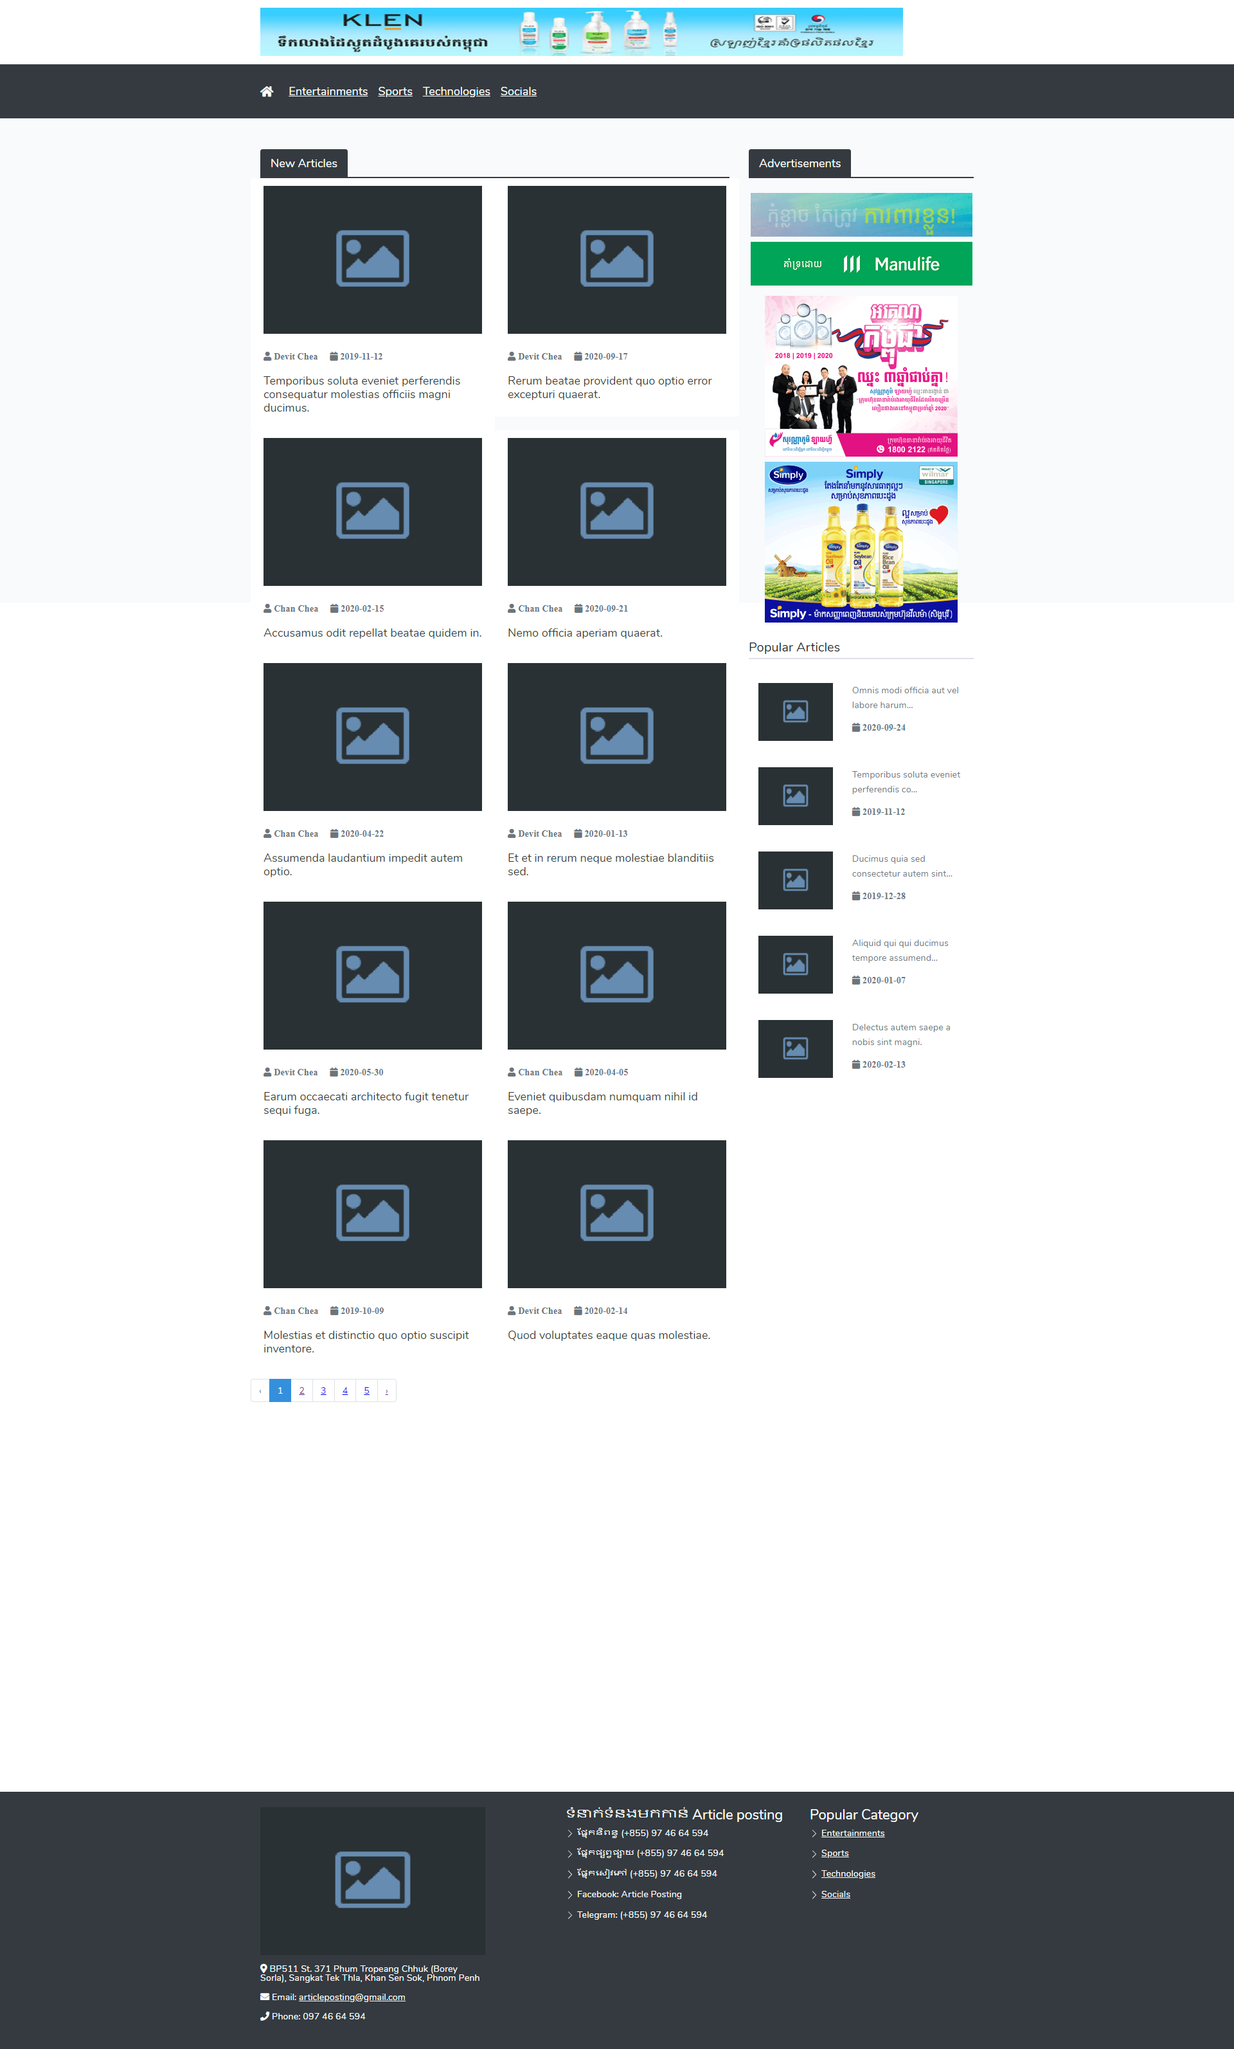
III. Project Features
Home Page

Slide 21
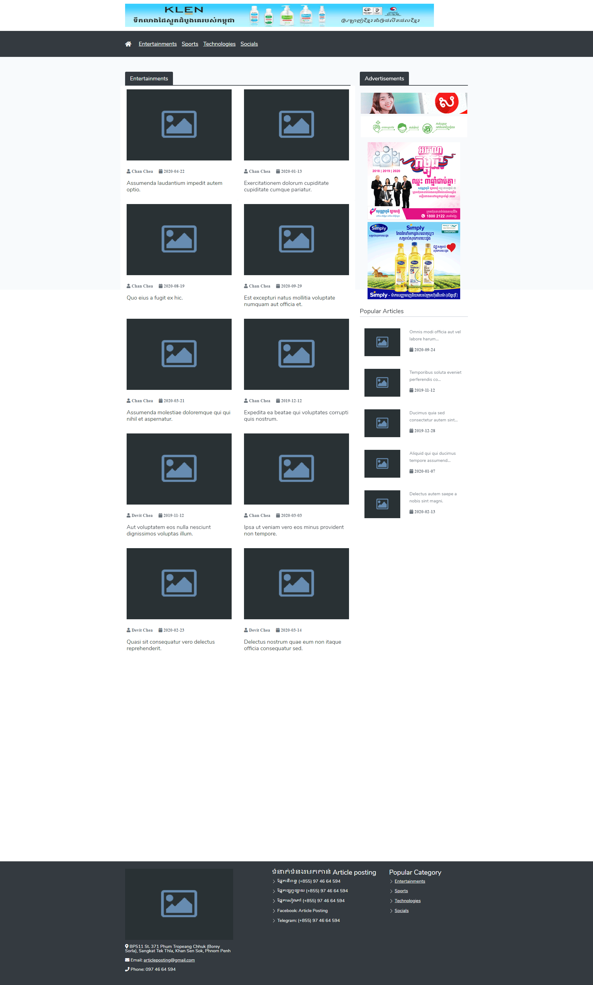
III. Project Features
Entertainments Page

Slide 22
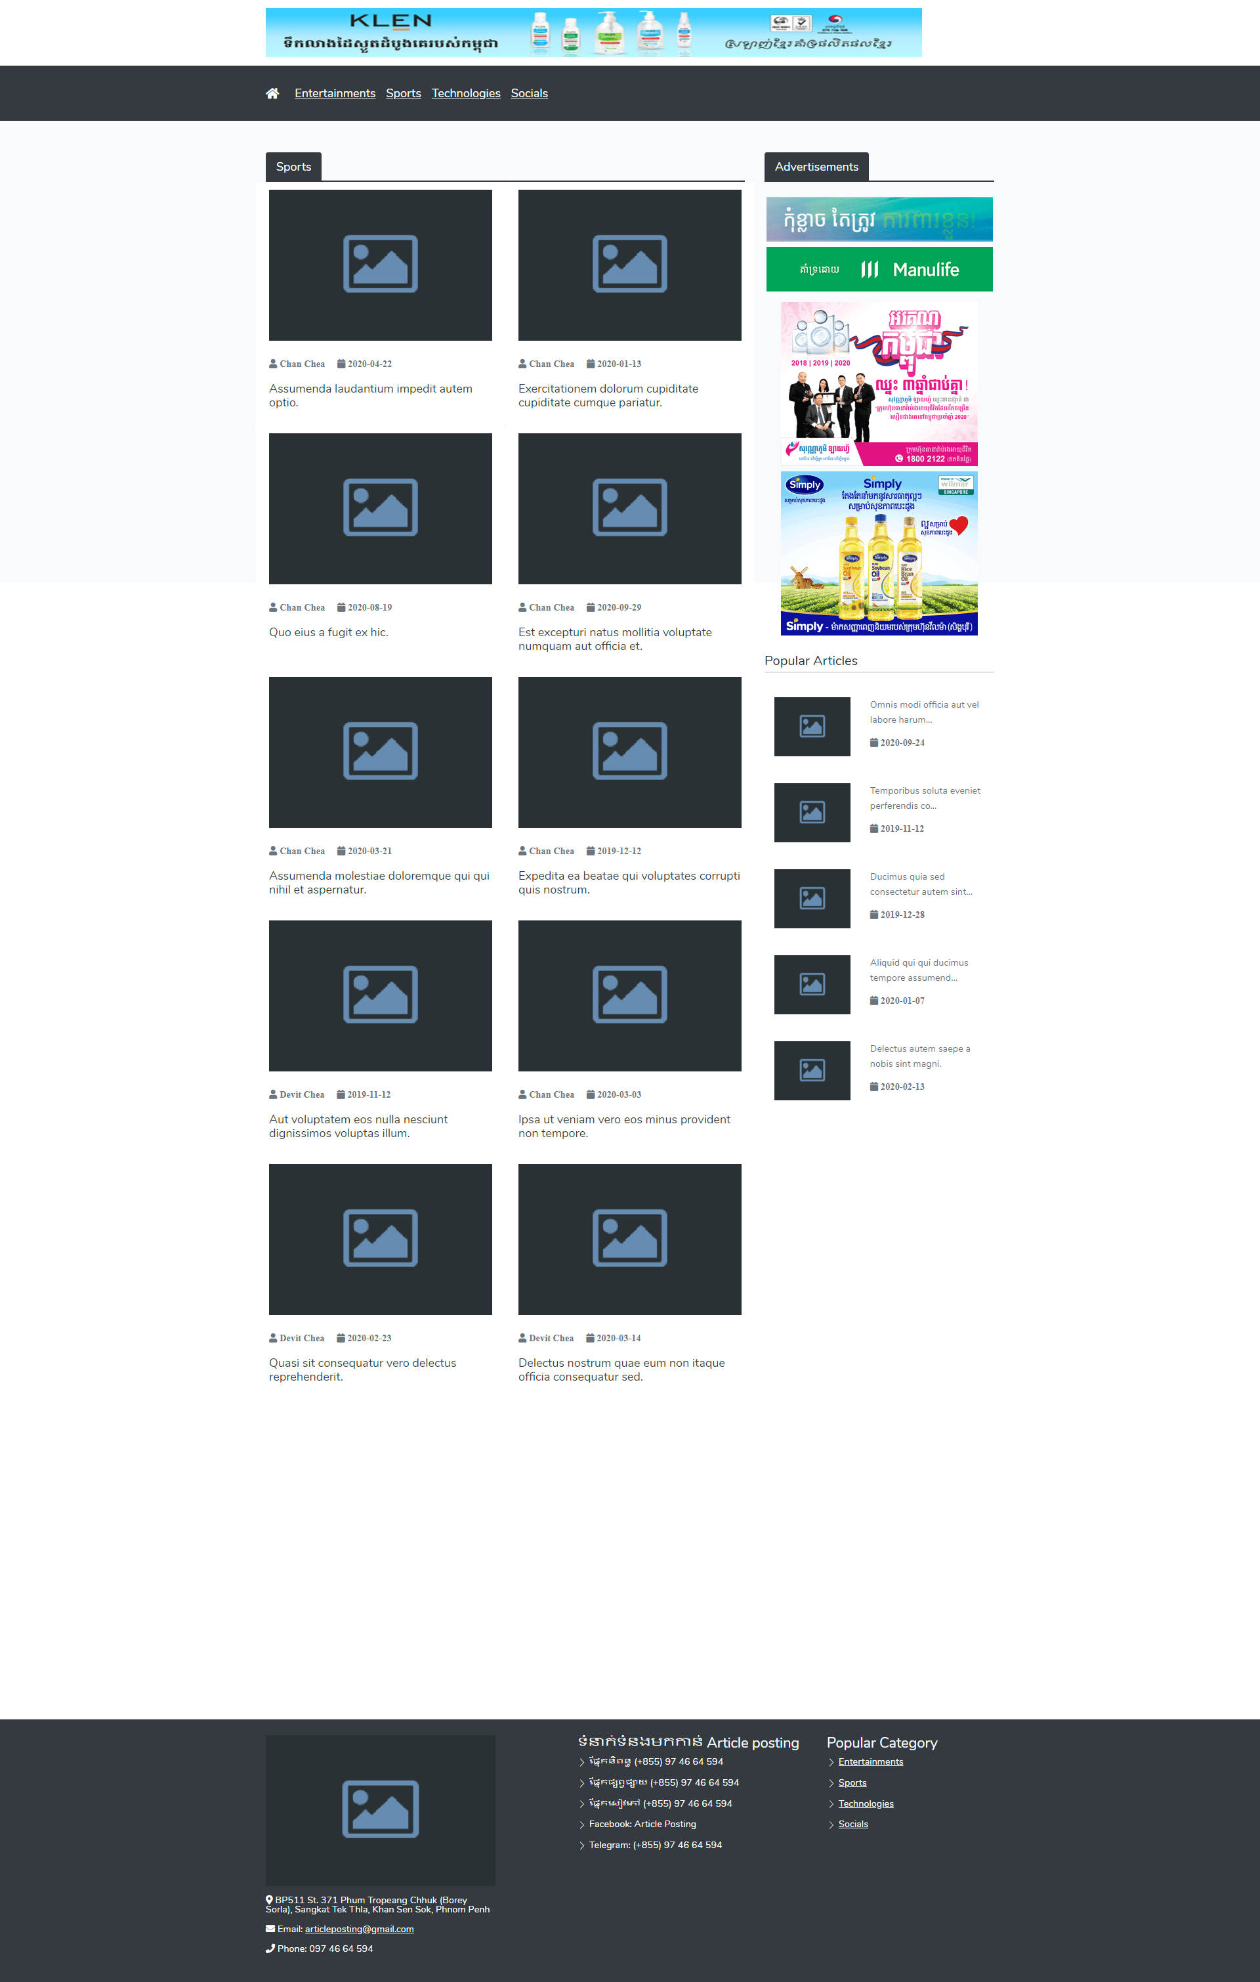
III. Project Features
Sport Page

Slide 23
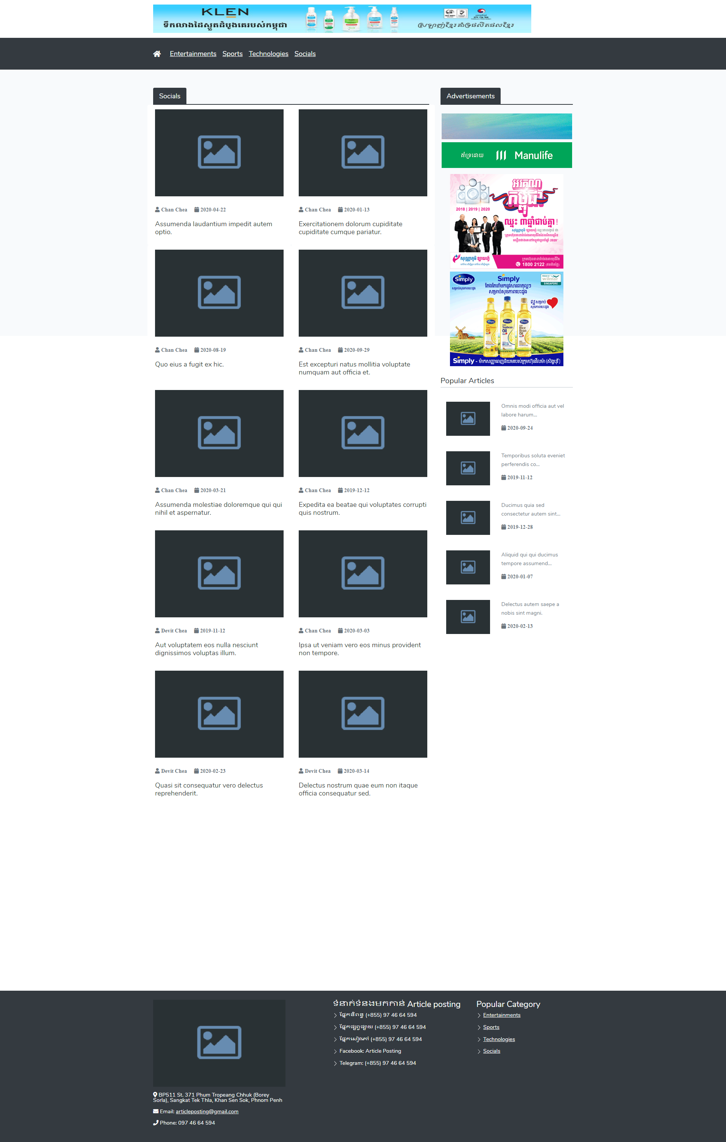
III. Project Features
Social Page

Slide 24
III. Project Features
Technology Page

Slide 25
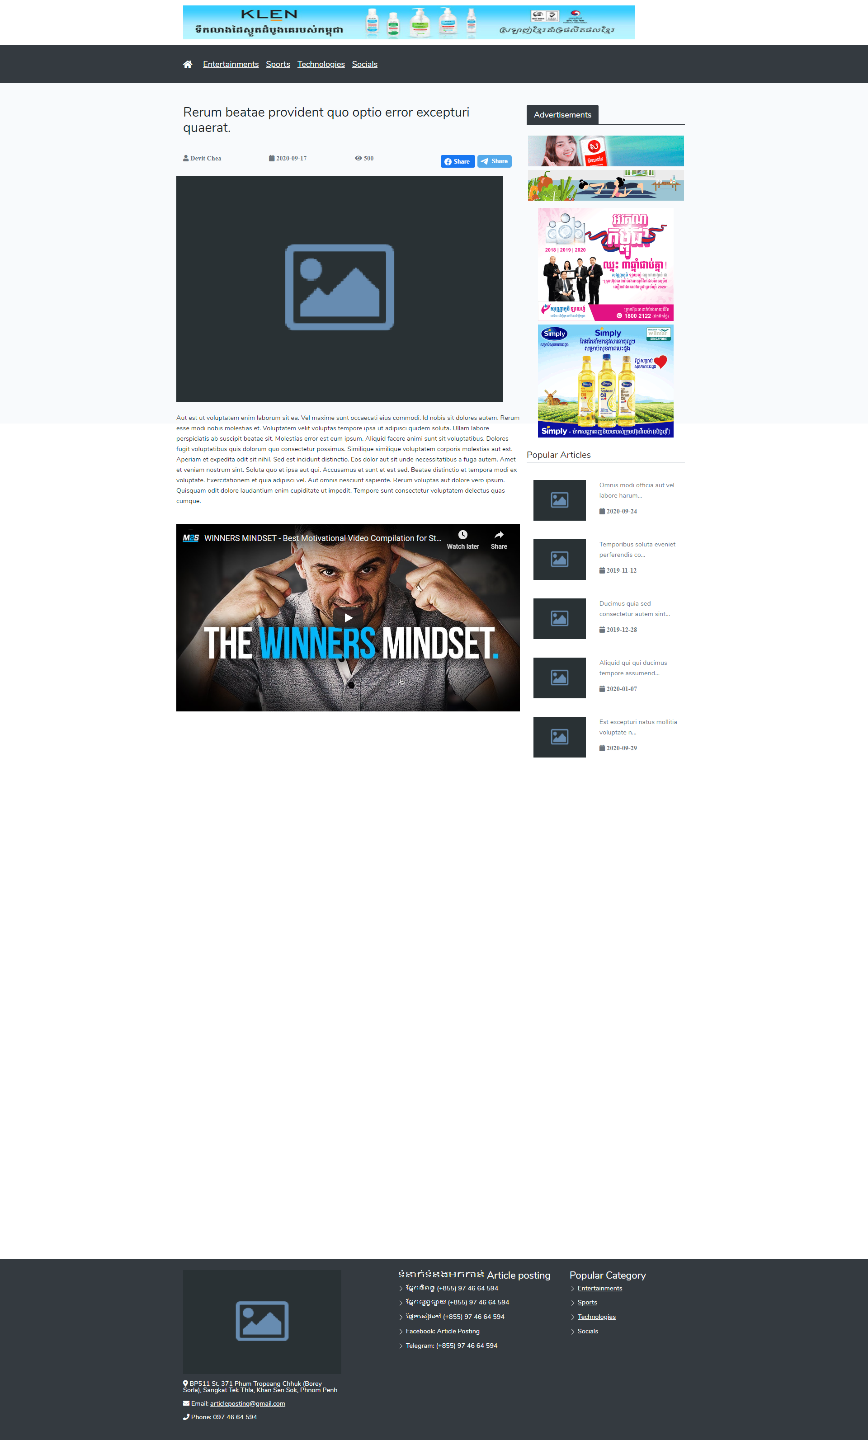
III. Project Features
Article Detail

Slide 26
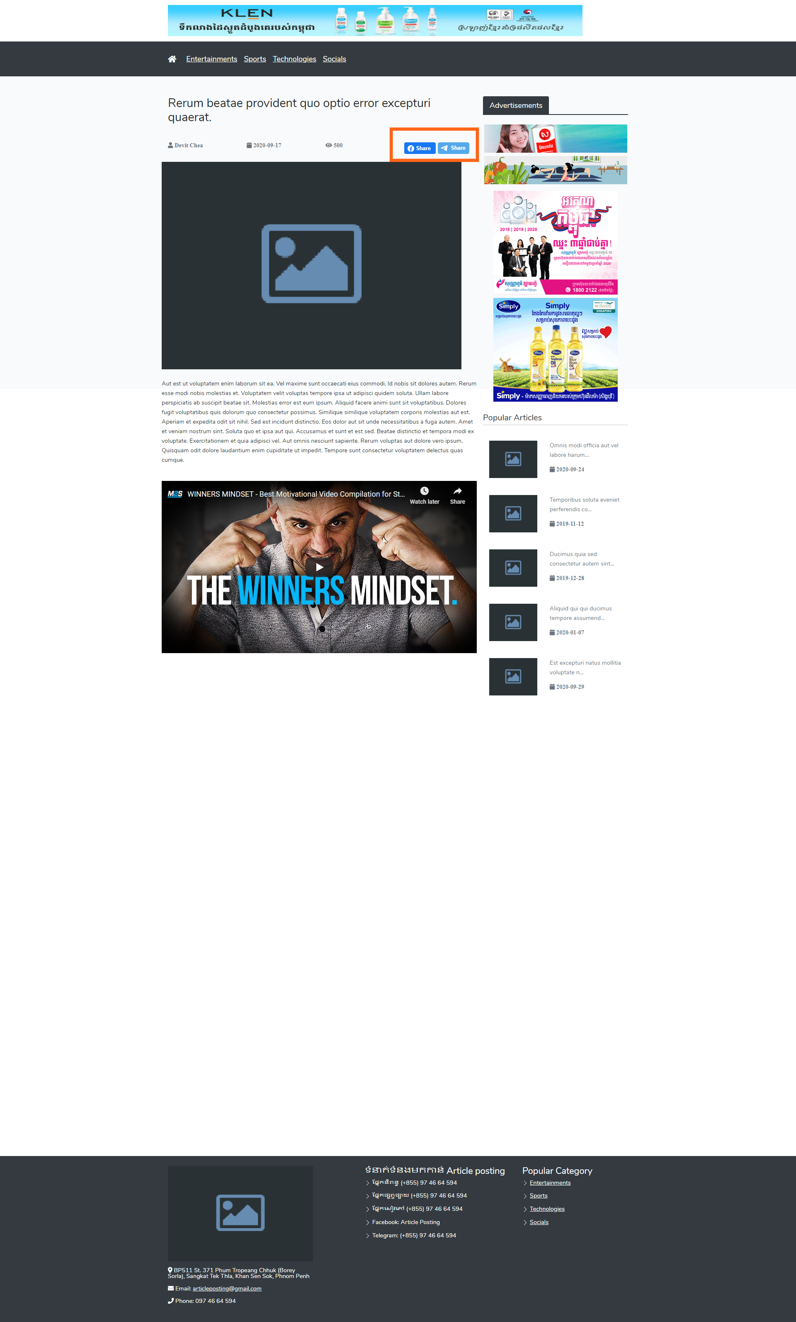
III. Project Features
Share to social media

Slide 27
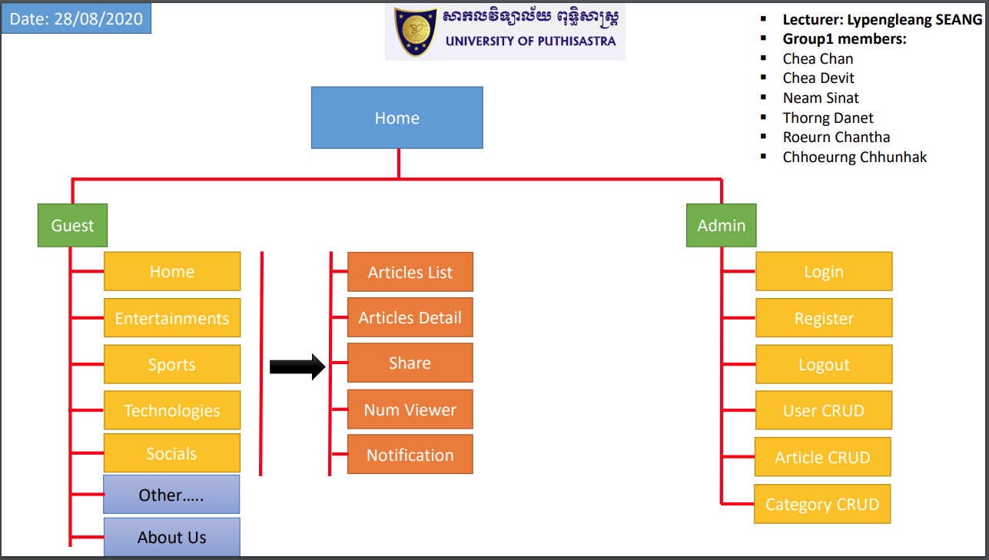
III. Sitemap

Slide 28
IV. Problems & Solutions
Problems
Not easy to find with the specific news
Many people miss many important information
Many people use smartphone and Pc more than TV
Solutions
Develop a website that can help the human to daily activities and for the user easy to find information with the different categories with images, video and can share to the social media.

Slide 29
V. Purpose
Easy to find all information just using smartphone or computer
Provide the user with good experience of information
User can share all information to their social media
Alert notification hot news for the user

Slide 30

Thank you for your attention

